Slide 1
Kathmandu, TU, September 21, 2010
Michel Waldschmidt, Professor,
Université P. et M. Curie (Paris VI) France
www.cimpa-icpam.org

Slide 2
CIMPA-ICPAM’s mission
To promote international cooperation for the benefit of developing countries, in higher education and research in Mathematics and their applications, as well as in related subjects
to this end CIMPA-ICPAM organizes research schools, supports seminars and sustains networks of researchers
its actions are concentrated at places where there is the will to further develop Mathematics, and where a research project is feasible
looking for three main equilibria : gender, geographic, and thematic

Slide 3
CIMPA-ICPAM research schools
Open call every year
proposals for two weeks schools come from everywhere, some encouraged by CIMPA-ICPAM members
members of the Scientific Council and the Governing Board select about 12 school projects
Schools are organized locally with scientific and administrative help from CIMPA-ICPAM, in a North-South-South format
New initiative: informal agreement with India and Argentina. They
will fund their participants to all neighbouring CIMPA-ICPAM school

Slide 4
CIMPA-ICPAM research schools
Young participants from neighbouring countries are selected by the organizers and CIMPA-ICPAM. They receive full financial support by CIMPA-ICPAM.
Lecturers and speakers are not paid. They obtain their own funding for travel and accomodation. CIMPA-ICPAM provides help in this direction (letters, explanation of the main purpose, contact with Scientific attachés of the local French Embassies)
Typical budget for a school is about 30k€ (CIMPA-ICPAM participation is about 10k€, mainly for young people from developing countries)

Slide 5
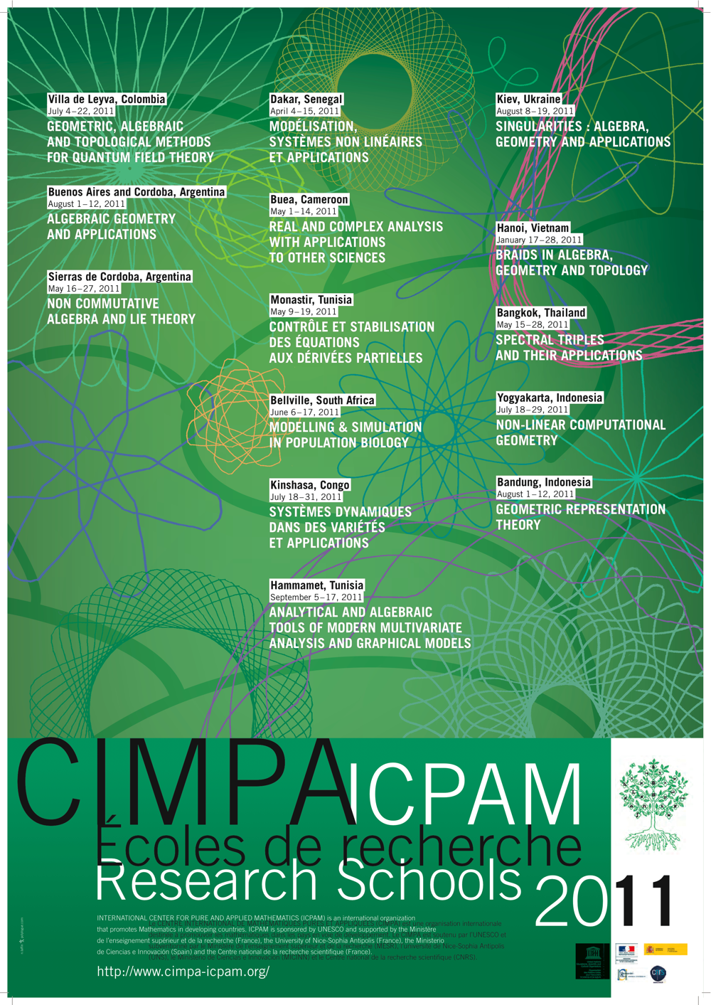
2011

Slide 6
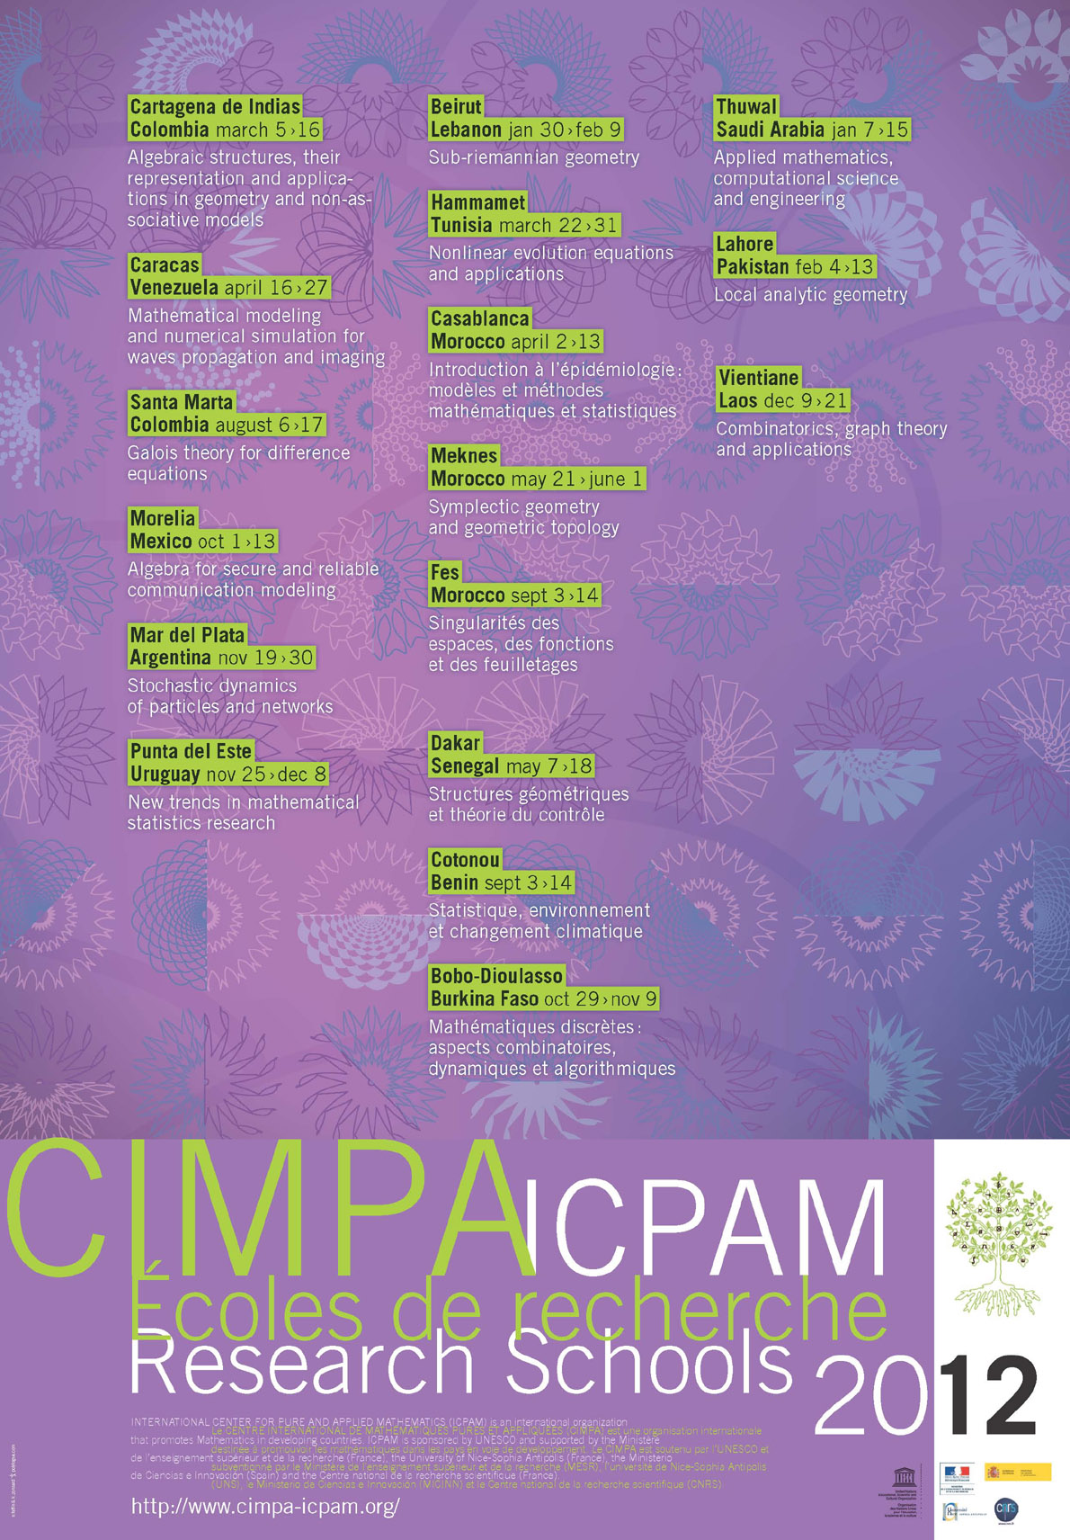
2012

Slide 7
Mediterranean 2012
Géométrie sous-riemannienne
CIMPA-UNESCO-MESR-MICINN-LIBAN
Beyrouth, Liban, 30 janvier - 9 février
Equations d’Evolution Non Linéaires et Applications
CIMPA-UNESCO-MESR-MICINN-TUNISIE
Hammamet, Tunisie, 22-31 mars
EpiCasa – Introduction à l’épidémiologie :
modèles et méthodes mathématiques et statistiques
CIMPA-UNESCO-MESR-MICINN-MAROC
Casablanca, Maroc, 2-13 avril

Slide 8
Sub-saharan Africa 2012
Structures Géométriques et Théorie du Contrôle CIMPA-ICTP-UNESCO-MESR-MICINN-SENEGAL En commun avec l’ICTP Dakar, Sénégal, 7-18 mai
Statistique, environnement et changement climatique CIMPA-UNESCO-MESR-MICINN-BENIN Cotonou, Bénin, 3-14 septembre
Mathématiques discrètes :
aspects combinatoires, dynamiques et algorithmiques
CIMPA-UNESCO-MESR-MICINN-BURKINA FASO
Bobo-Dioulasso, Burkina Faso, 29 octobre - 9 novembre

Slide 9
South-east Asia 2012
Théorie des graphes, combinatoire et applications
CIMPA-UNESCO-MESR-MICINN-LAOS
Vientiane, Laos, 9-21 décembre

Slide 10
Latin America and Caribbean 2012
Algèbre pour la modélisation de communication sécurisée et fiable (ASReCoM)
CIMPA-UNESCO-MESR-MICINN-MEXIQUE
Morelia, Mexique, 1-13 octobre
Stochastic dynamics of particles and Networks
CIMPA-UNESCO-MESR-MICINN-ARGENTINE
Mar del Plata, Argentine, 19-30 novembre
Nouvelles tendances dans la recherche en Statistique mathématique
CIMPA-UNESCO-MESR-MICINN-URUGUAY
Punta del Este, Uruguay, 25 novembre - 8 décembre

Slide 11
Latin America and Caribbean 2012
Algebraic Structures, their representation and applications
in geometry and non-associative models
CIMPA-UNESCO-MESR-MICINN-COLOMBIE
Cartagena de Indias, Colombie, 5-16 mars
Modélisation mathématique et simulation numérique
pour la propagation d’ondes et l’imagerie
CIMPA-UNESCO-MESR-MICINN-VENEZUELA
Caracas, Venezuela, 16-27 avril
Galois Theory for difference equations
CIMPA-UNESCO-MESR-MICINN-COLOMBIE
Santa Marta, Colombie, 6-17 août

Slide 12
2012 INDIA, CENTRAL AND WEST ASIA
Applied Mathematics, Computational Science and Engineering
CIMPA-UNESCO-MESR-MICINN-ARABIE SAOUDITE
Thuwal, Arabie Saoudite, 5-12 janvier
Local Analytic Geometry
CIMPA-ICTP-UNESCO-MESR-MICINN-PAKISTAN
En commun avec l’ICTP
Lahore, Pakistan, 4-13 février

Slide 13
Other regions
Singularities : algebra, geometry and applications
CIMPA-UNESCO-MICINN-UKRAINE
Kiev, Ukraine, August 8-19

Slide 14
Some complementary activities
AFRICA:
UNESCO Chair (Tunisia)
SARIMA (Mathematics and Computer Science in Africa)
CARI (Conference on Research in Computer Science)
WATS (West African Training Schools), Ecoles Mathématiques Africaines (EMA)
LATIN AMERICA:
EMALCAs
REALMA (European and Latin American network in applied mathematics)
MIDDLE EAST: MA3N (Mathematical Analysis & Application Arab Network)
SOUTH EAST ASIA:
Cambodia, Laos, (regional master program)
IMAMIS, SEAMS

Slide 15
Numbers
180 research schools
101 participations in higher level education and research networks (seminars, workshops and doctoral courses)
Countries
18 from Africa
11 from Asia
13 from South America and Caribbean
8 from the Middle East
4 from Central and Eastern Europe
10007 young mathematicians
700 speakers, 110 from Southern countries

Slide 16
Research schools numbers
180 CIMPA-ICPAM research schools in the fields of Pure and Applied Mathematics and Computer Science in 54 countries:
51 schools in Africa
50 schools in Asia
49 schools in Latin America and Caribbean
26 schools in the Middle-East
4 schools in Eastern Europe

Slide 17
CIMPA-ICPAM’s history
CIMPA-ICPAM is:
a non-profit organization created in 1978 with office at Nice, France
currently funded by the Ministère de l’enseignement supérieur et de la recherche (France), the University of Nice-Sophia Antipolis (France), the Ministerio de Ciencia e Innovación (Spain) and the Centre national de la recherche scientifique (France)
a category 2 center of UNESCO since the 90’s

Slide 18
CIMPA-ICPAM organization
CIMPA-ICPAM is a category 2 UNESCO center
with permanent institutional members (UNESCO, French Ministries, MICINN, Université de Nice)
with a Executive Board elected for a 4 years term by the General Assembly
with a Scientific Council and a Steering Council
with a Management team consisting of a Director, five Regional Scientific Officers and an Officer in charge of communications
Notes:
The Director holds a full time position at the Université de Nice. Colleagues at the Scientific Council, the Executive Board and the Management team serve on a voluntary basis

Slide 20
Scientific Council
Chairman: Enrique ZUAZUA (Spain) (Applied Maths)
Jean-Marc AZAÏS (France) (Probability, statistics)
Viviane BALADI (France) (Dynamical systems)
Edy Tri BASKORO (Indonesia) (Graph theory)
Suzanne BRENNER (USA) (Numerical analysis)
Maria Luiza FERNANDEZ (Spain) (Differential geometry)
Vaughan JONES (USA) (Fields Medal)
Orlando LOPES (Brazil) (PDE, Non linear analysis)
Youssef OUKNINE (Marocco) (Probability, stochastic equations)
Carlos DI PRISCO (Venezuela) (Logic)
Ragni PIENE (Norway) (Algebraic geometry)
Ramdorai SUJATHA (India) (Number theory, K-Theory)

Slide 21
Executive Board
President: TSOU Sheung Tsun
University of Oxford (Mathematical physics)
Vice‐President: Alain DAMLAMIAN
Université Paris 12 (Nonlinear analysis, nonlinear partial diff. equations)
Secretary: Jean-Marc BARDET
Université Paris 1 (Probabillty and statistics)
Treasurer : Bernard ROUSSELET
Université de Nice (Nonlinear vibrations, optimisation)

Slide 22
Management team
Director : Claude CIBILS (Université Montpellier, on leave at Université de Nice)
Regional scientific officers:
Sub-saharan Africa: Marie-Françoise ROY (Université de Rennes 1)
Latin America and Caribbean: Claude CIBILS
South-east Asia: Michel JAMBU (Université de Nice) +
Christian MAUDUIT (Université de Marseille)
India and West Asia: Michel WALDSCHMIDT (Université de Paris 6)+ Jorge Jimenez URROZ (Université de Barcelone, Spain)
Mediterranean: Ahmad EL SOUFI (Université de Tours)
Communication responsible: Rosane USHIROBIRA (Université de Bourgogne)

Slide 23
Scientific partners
Université de Nice Sophia-Antipolis (UNS), Institut National de Recherche en Informatique et en Automatique (INRIA), Centre National de la recherche Scientifique (CNRS), Société Mathématique de France (SMF),Société de Mathématiques Appliquées et Industrielles (SMAI), International Mathematical Union (IMU), International Council for Industrial and Applied Mathematics (ICIAM), European Mathematical Society (EMS), International Centre for Theoretical Physics (ICTP), Union Mathématique Africaine (UMA), South East Asian Mathematical Society (SEAMS), Union Mathématique d'Amérique Latine et Caraïbes (UMALCA), Comité National Français des Mathématiciens (CNFM), Centro de Modelamiento Matematico (CMM), Bordeauxthèque, Institut de Recherche pour le Développement (IRD), Comité Español de Matemáticas (CEMAT), Real Sociedad Matemática Española (RSME), Societat Catalana de Matemàtique (SCM), Sociedad Española de Matemática Aplicada (SEMA), Sociedad Española de Estadística e Investigación operativa (SEIO)

Slide 24
A new era for CIMPA-ICPAM
The convention MICINN (Ministerio de Ciencia e Innovación, Spain) - CIMPA brings new perspectives:
it will allow CIMPA-ICPAM to respond to more requests of help from developing countries, much more than we can support at the moment
it is a first step towards the internationalization of CIMPA-ICPAM
New agreements (2011) with Norway and Switzerland

