Slide 1
CIMPA
Roma 3 - January 2015
Michel Waldschmidt

Slide 2
CIMPA’s mission
To promote international cooperation for developing research in mathematics.
To this end CIMPA organizes Research Schools, supports activities in partnership with continental mathematical societies as well as funding for training in research.
Notes:
2

Slide 3
CIMPA’s mission
a main endeavour is to maintain three equilibria: gender, geography and subject,
proposals in the most mathematically or economically deprived areas are encouraged and will be given priority,
we act where there is a will to further develop mathematics and where a research project is sustainable.
Notes:
3

Slide 4
CIMPA’s history
CIMPA is:
a non-profit organization created in 1978. Mathematicians working for mathematicians. Offices in Nice, France,
mainly funded by France. More recently also funded by Spain, Norway and Switzerland,
a category 2 centre of UNESCO since the 90’s.
Notes:
4

Slide 5
CIMPA’s organization
Our General Assembly elects 7 individual members to the Governing Board,
Institutional members are UNESCO, France, Norway and Spanish Ministries, University of Nice and CNRS,
The GB elects its 4 member Executive Committee (Bureau in French),
A Scientific Council and a Steering Council,
The Director is appointed by the GB, he leads CIMPA with the help of his Management Team.
Notes:
The Director holds a full time position at the Université de Nice. Colleagues at the Scientific Council, the Executive Board and the Management team serve on a voluntary basis
5

Slide 6
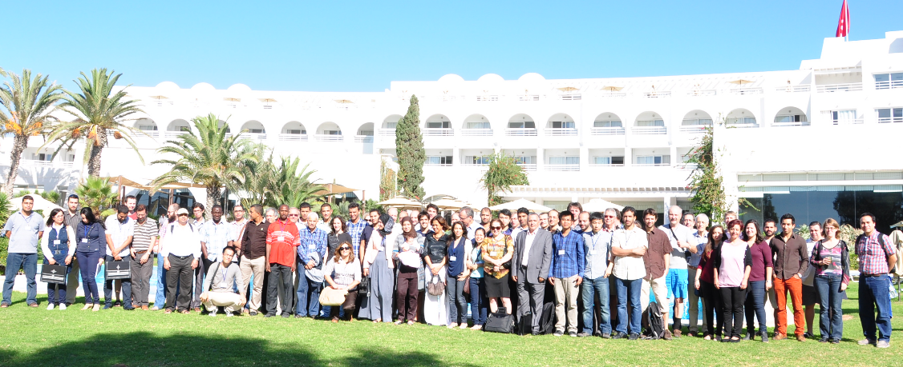
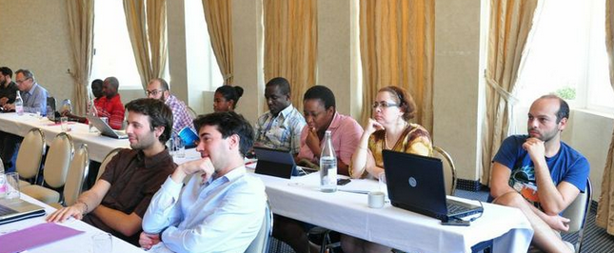
CIMPA Research Schools
Levy processes and self-similarity
Tunis Hammamet Novembre 2013
OUGADOUGOU - 2009
Notes:
6

Slide 7
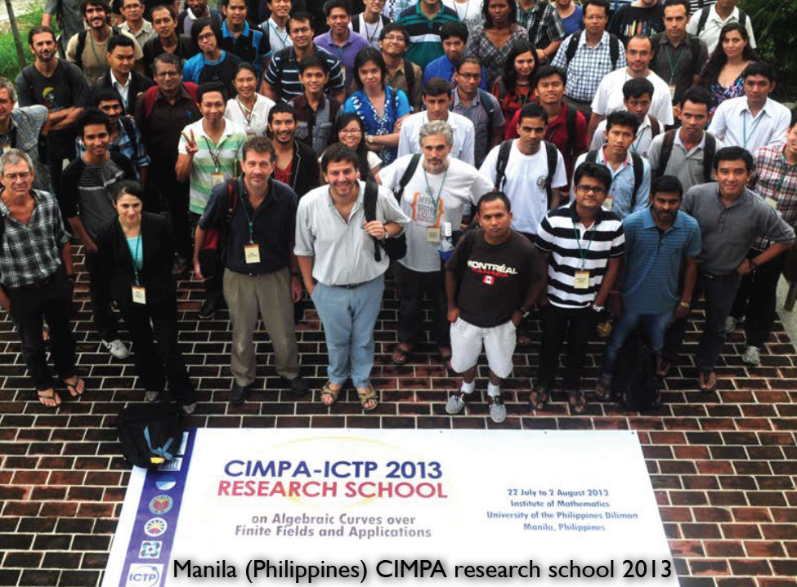
CIMPA Research Schools
OUGADOUGOU - 2009
Notes:
7

Slide 8
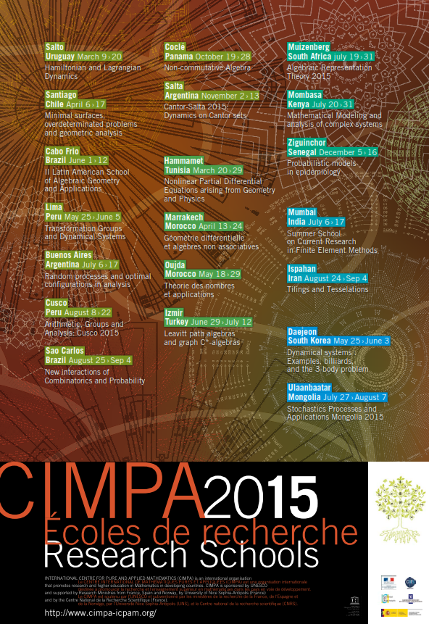
2015
Notes:
8

Slide 9
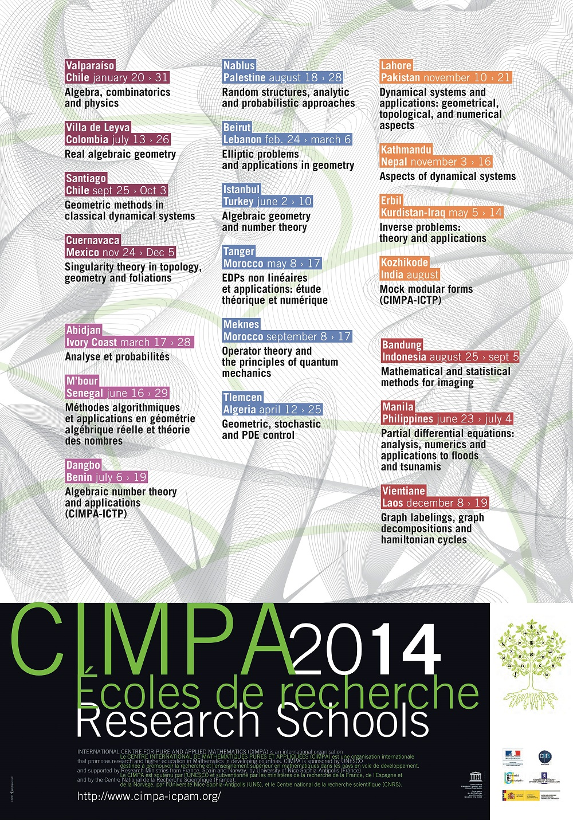
2014

Slide 10
CIMPA Research Schools
Open call every year: proposals for two-week schools come from everywhere, some are encouraged by CIMPA members,
the road-map is crucial, organization is local with help from CIMPA, using a North-South-South format.
the Scientific Council evaluates and makes recommendations,
the Steering Council selects around 20 research school projects.
The open call procedure is in accordance with a decision of the GA of CIMPA in June 2014 reinforcing our commitment and which we apply everywhere:
Each support by CIMPA will correspond to a selection carried out following an open call for projects.
Notes:
10

Slide 11
CIMPA Research Schools
Young mathematicians from neighboring countries apply (CV, motivation and recommendation letters),
The organizers and CIMPA makes a selection and several receive full CIMPA financial support (at least 2/3 of CIMPA total support is to this end),
Lecturers and speakers are not paid. In most cases they use their own funding for travel,
CIMPA helps through letters, discussions with organizers, explanation to authorities and/or fund raising.

Slide 12
Numbers
279 Research Schools since 1979
Countries by continent:
Africa : 18
Asia : 12
Latin America and Caribbean : 13
Middle East : 8
13500 young mathematicians
2500 speakers, 1100 from developing countries
Notes:
12

Slide 13
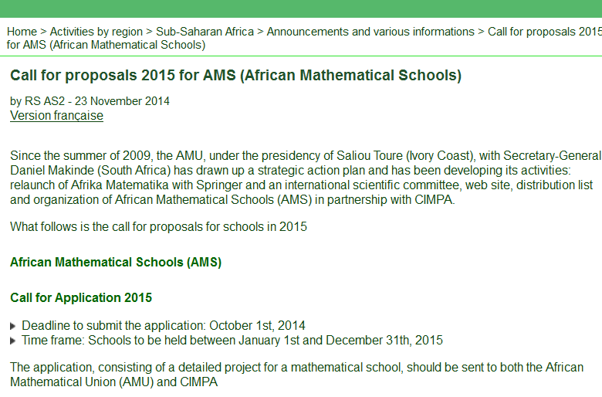
EMALCAs, AMS, SEAMS and WAMS
AMS 2015 with the African Mathematical Union
Franceville, Gabon, 23/03 – 03/04
Ziguinchor, Sénégal, 23/03 - 03/04
Cap Vert, 13/04 – 28/04
Yamoussoukro, Ivory Coast, 01/06 – 13/06
Makerere, Ouganda, 06/07 – 17/07
Yaoundé, Cameroun, 07/09 – 26/09
Marrakech, Maroc, 12/10 – 30/10
West Asia Mathematical Schools 2015
Erbil, Kurdistan-Irak, 19/04 – 30/04
Notes:
13

Slide 14
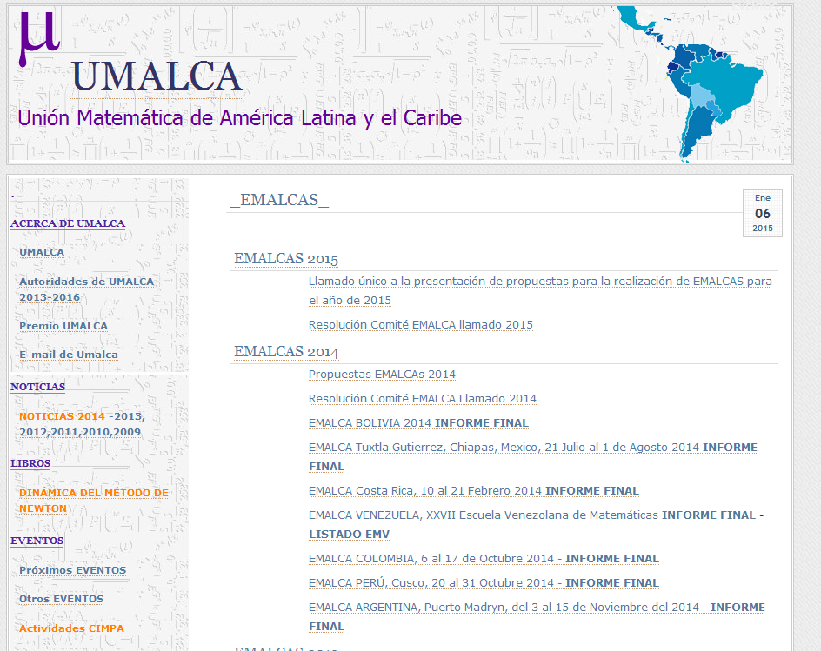
EMALCAs, AMS, SEAMS and WAMS
We impulse and we support advanced mathematics schools (Master Degree level) in partnership with continental mathematical unions.
EMALCAs 2015, with Union de Matematicos de America Latina y el Caribe
Perou - Piura - 03/08 - 14/08
Argentina - Tucuman - 11/08 - 22/08
Venezuela - Mérida - 30/08 - 04/09
Bolivia - Copacabana - 14/09 - 26/09
Nicaragua - Leon - 07/12 - 16/12
Mexico – Puebla – 15/06 – 26/06
Notes:
14

Slide 15
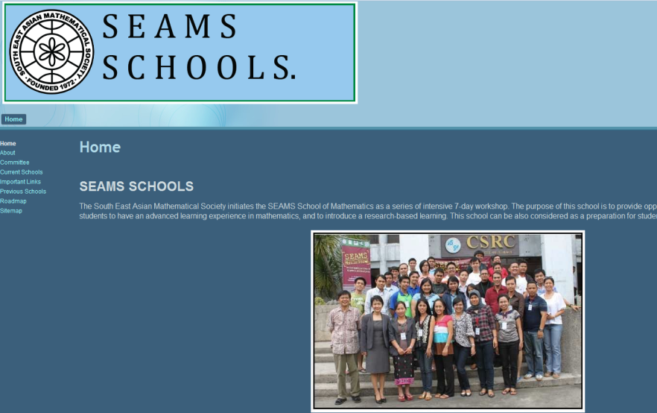
EMALCAs, AMS, SEAMS and WAMS
SEAMS 2015 schools with the South East Asian Mathematical Society
Hanoi – Vietnam, 01/03 – 15/03
HCMC – Vietnam, 31/08 – 08/09
Sanata Dharma,Yogyakarta, Indonesia, 07/09 – 15/09
Makassar, South Sulawesi, Indonesia, 28/09 – 06/10
Serdang, Selangor, Malaysia, 02/10 – 10/10
Gadjah Mada,Yogyakarta, Indonesia, 09/11 – 17/11
Notes:
15

Slide 16
CARMIN
CARMIN is an “Excellence Laboratory” in France leaded by Cédric Villani (Fields Medalist), composed of four centres:
and CIMPA.

Slide 17
FUNDING FOR TRAINING IN MATH RESEARCH
Priority in the most mathematically or economically deprived areas, and very specially in Africa,
Projects (between 2 to 4 weeks) for teaching at Master level,
Proposals with Director’s opinion are addressed to the Bureau, which make decisions in liaison with the Scientific Council.

Slide 18
Thank you.

